Slide 1
Well Being- Prediction Analysis
GROUP-26:
1.Salma Chanbasha Nandikotkur
2.Satish Tirumalapudi

Slide 2
85,670,000
That’s the number of americans suffering with Diagnosable Personality Disorder

Slide 3
Problem Statement:
To predict the well being of a person and does he/she require treatment.
This project aims to build machine learning models which can predict whether person requires treatment or not based on the specific features and identifying the importance of factors which can help HR to see what factors that the company needs to support so the employee wants to get mental health treatment.

Slide 4
Data Source(Working Data set):
After thorough research of the literature, we were able to find a dataset that could help us this analysis and prediction.
This dataset was a survey that measures attitudes towards psychiatric behavior and frequency of health disorders in a tech workplace.
The dataset is called Personality Disorder in Tech.
Link: https://osmhhelp.org/research

Slide 5
Dataset :
The dataset we choose has 27 columns of different attributes that are considered for mental health.
Some of the columns in the dataset are:
Timestamp ,Age ,Gender ,Country ,state.
self_employed: Are you self-employed?
family_history: Do you have a family history of mental illness?
treatment: Have you sought treatment for a mental health condition?
work_interfere: If you have a mental health condition, do you feel that it interferes with your work?
no_employees: How many employees does your company or organization have?
remote_work: Do you work remotely (outside of an office) at least 50% of the time?
tech_company: Is your employer primarily a tech company/organization?
benefits: Does your employer provide mental health benefits?
anonymity: Is your anonymity protected if you choose to take advantage of mental health or substance abuse treatment resources?
leave: How easy is it for you to take medical leave for a mental health condition?
comments: Any additional notes or comments

Slide 6
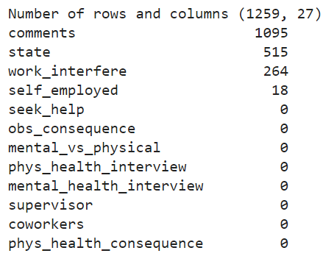
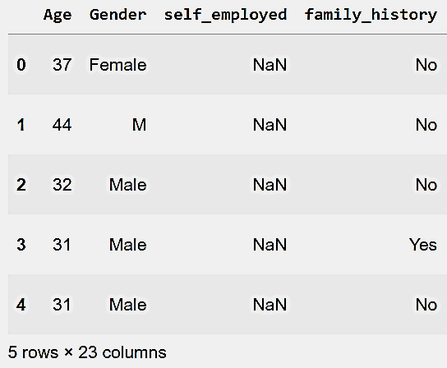
Data Preprocessing :
Checking for Missing values.
Drop the Missing values columns
and few columns which are not related.
Assign Default values for each data type

Slide 7
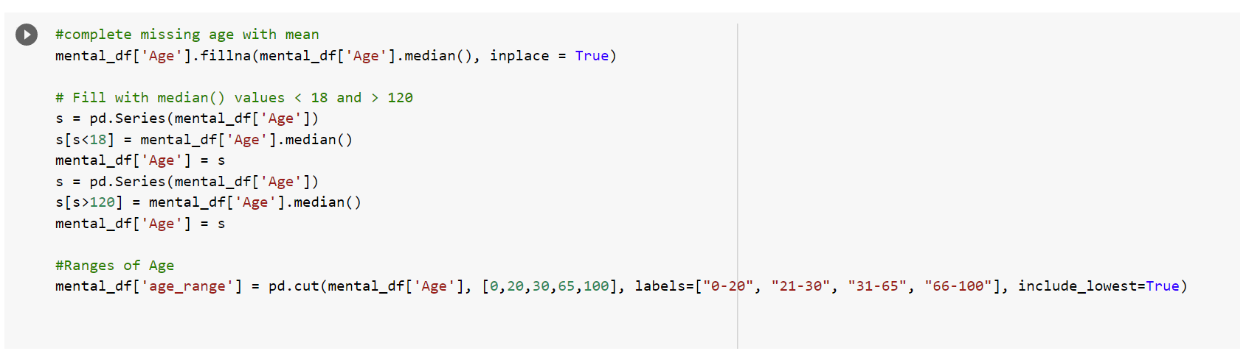
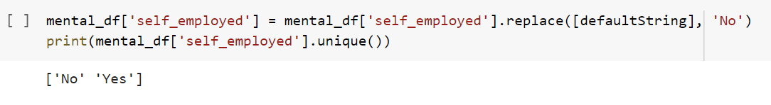
Data Preprocessing:
Cleaning Gender Column by categorizing
all the unique values
Replacing the missing values with the mean and the outliers with the medians
Replacing the smaller number of default values with less valued variable in the respective column.

Slide 8
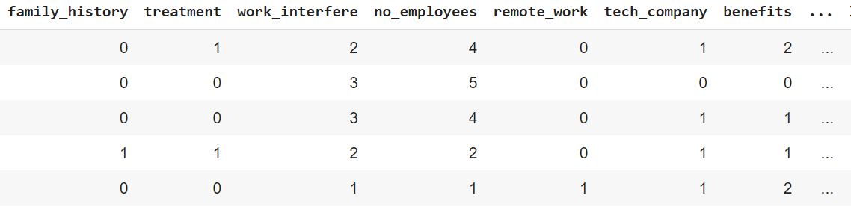
Encoding
Encoding is a part of data preprocessing. It refers to converting the labels into numeric form, to convert them into machine readable form.
Most machine learning models only accept numerical variables, preprocessing the categorical variables becomes a necessary step.
Here we did Label Encoding ,Each label is converted into an integer value.

Slide 9
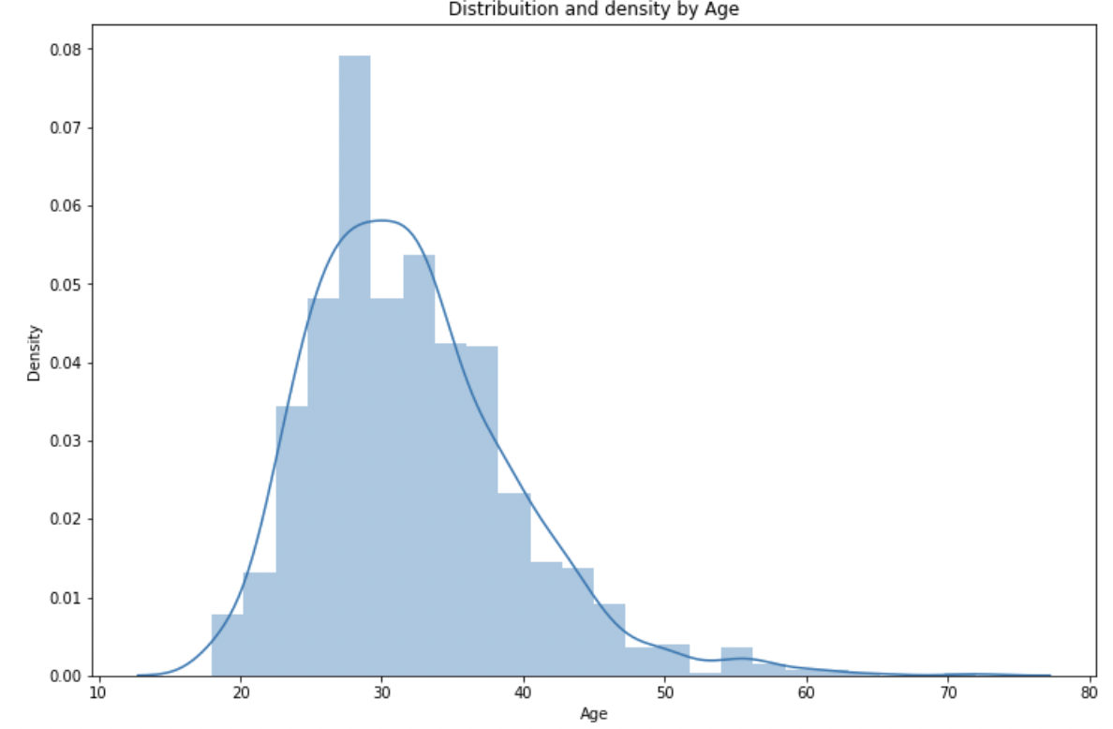
Exploratory Data Analysis:
Distribution and density by Age:
Notes:
The graph here shows the density of people by age, which helps us in understanding the age-range within the dataset

Slide 10
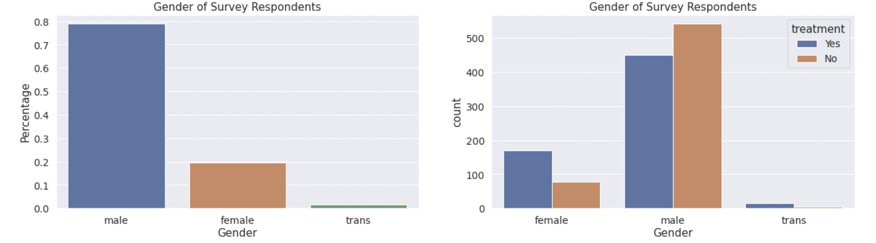
Gender of Survey Respondents

Slide 11
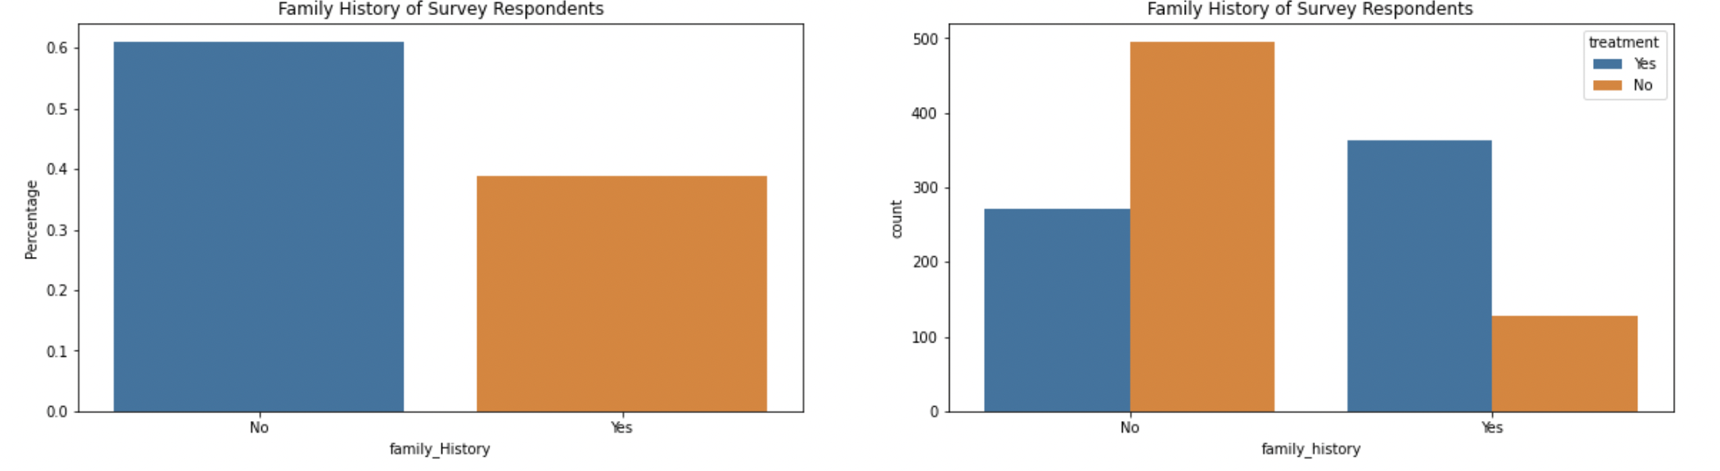
Family History of Survey Respondents
Do you have a family history of mental illness?'
Notes:
Around 40% people have responded saying that they have a family history with the mental illness and people with family history of mental illness requires treatment compared to the no family history of mental illness. Family history is a significant factor in menta health disorders.

Slide 12
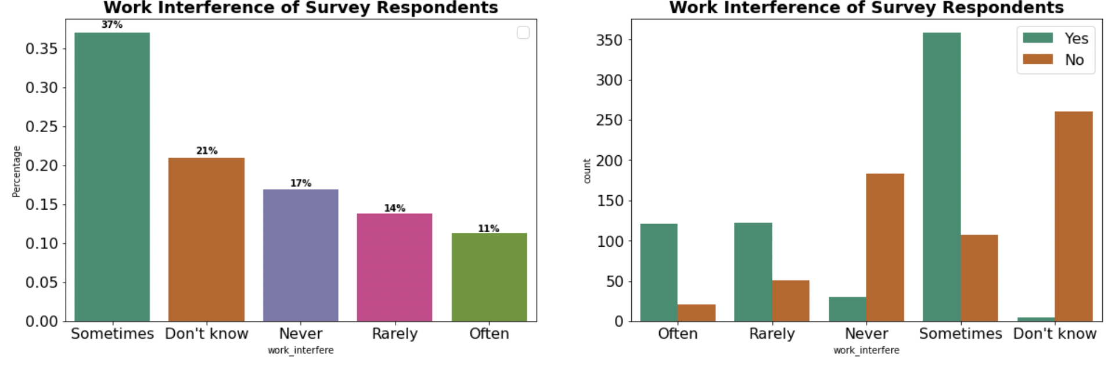
Work interference of Survey Respondents
If you have a mental health condition, do you feel it interferes with your work?
Notes:
Around 37% people have responded that work interference that it sometimes where people doesn’t want to share about it or shy about sharing it. And they still require treatment for the mental health and the similar pattern is observed with Often..
What is really interesting here is who have responded with never, around 80 % of them are requiring treatment, because of the variety of reasons.

Slide 13
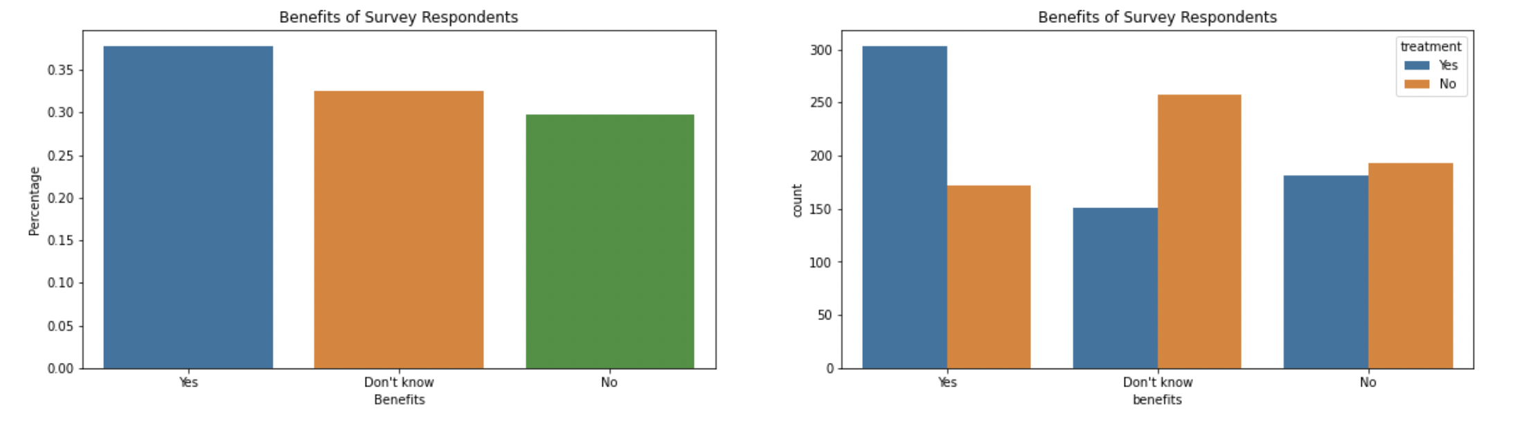
Benefits of Survey Respondents
Does your employer provide mental health benefits: 38%
Notes:
We see 38% and around 32% doesn’t know whether they provide benefits or not.
Around 63 % people who know that their company provides mental benefits were seeking medical help and

Slide 14
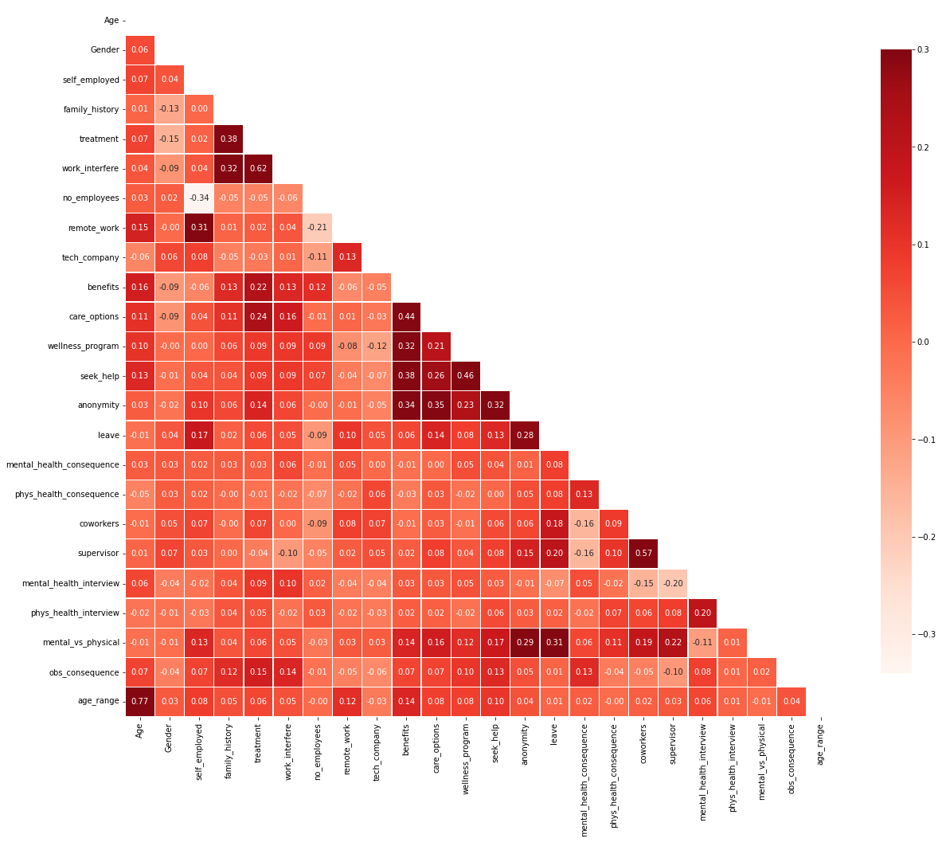
Correlation matrix is built here using the corr() function between all the variables within the dataset.
We observe some strong correlations here between the work_interfere,anomity ,benefits,leave,gender,
family_history.
Notes:
It helps us to understand the direction, the form of the relationship and the degree(strength) of the relationship.

Slide 15
ML Models
The Machine learning models we applied on this dataset are:
Logistic Regression
K- Nearest Neighbors
Decision Tree
Random Forests

Slide 16
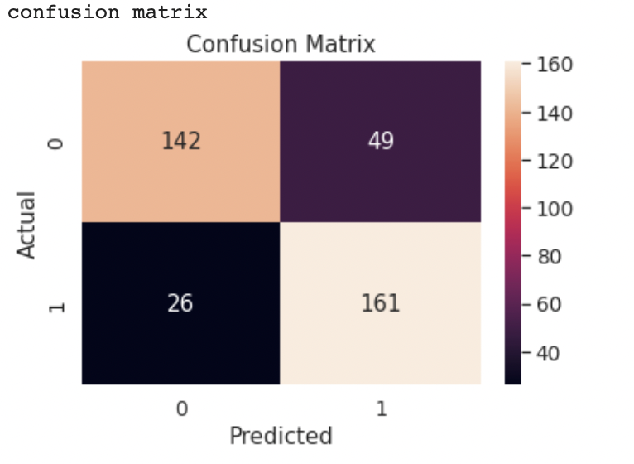
Logistic Regression:
By using this model the accuracy, we obtained is 80.158
True positive rate(sensitivity)=0.86
False Positive rate=0.25
Precision=0.68

Slide 17
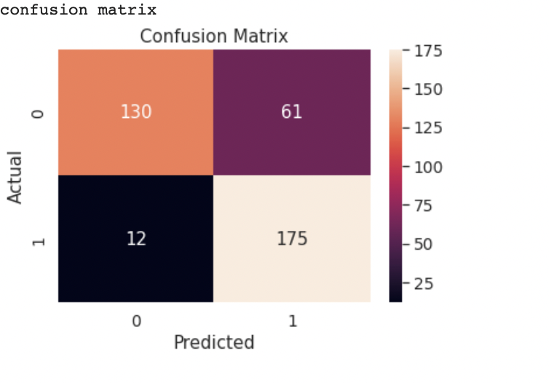
Decision Tree
By using this model the accuracy, we obtained is 80.687
True positive rate(sensitivity)=0.93
False Positive rate=0.31
Precision=0.72

Slide 18
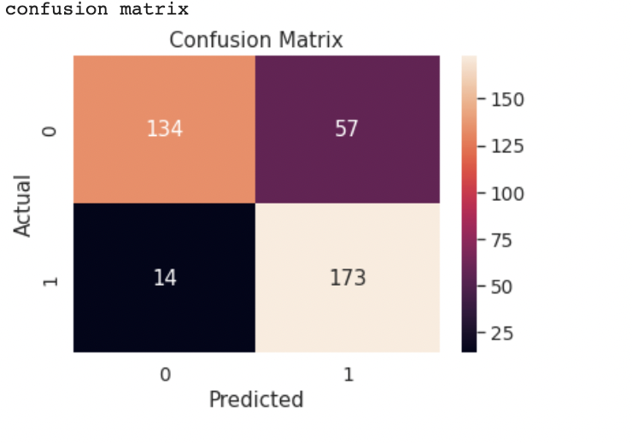
Random Forest
By using this model the accuracy, we obtained is 81.216
True positive rate(sensitivity)=0.92
False Positive rate=0.29
Precision=0.73

Slide 19
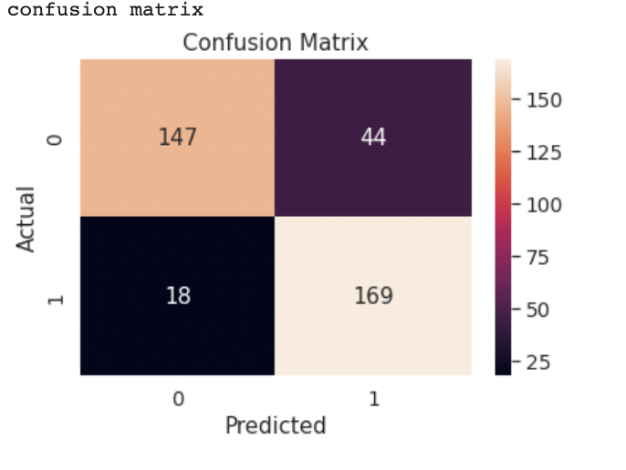
K-Nearest Neighbors:
By using this model the accuracy, we obtained is 83.597
True positive rate(sensitivity)=0.90
False Positive rate=0.23
Precision=0.71

Slide 20
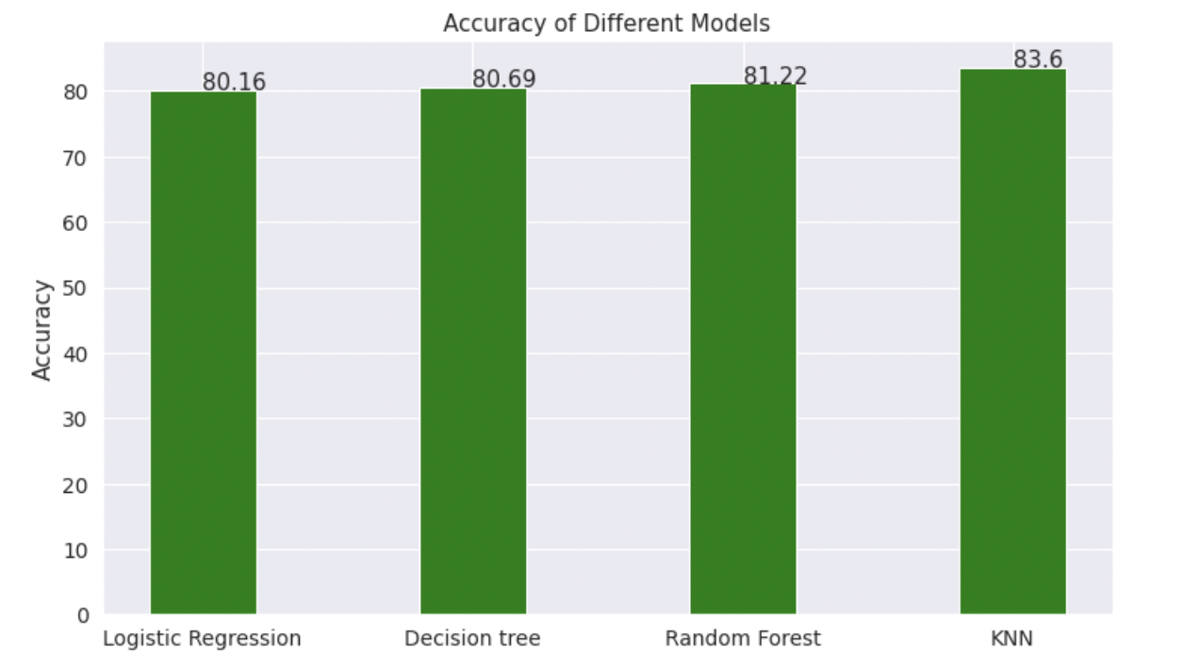
Evaluation of Models:

Slide 21
Evaluation
We came to know that the most important factors to predict whether the person requires treatment for the mental health condition are age, family_history, anonymity ,leave and work_interfere.
Also, we did observe a strong relationship with the Family History as the people with mental health history requires more attention towards the treatment than the other.
Another insight we observed is as companies tend to provide more health benefits the people requiring treatment is less . So, the companies should concentrate more on the benefits to provide for the wellbeing of a person.

Slide 22
Recommendations:
With an usage of the other valid features, there can be better predictions on the person’s well-being.
We can try some more predictive models on this data set to get more accuracy.
Learnt all about analysis and predictions and how to implement In-Class Concepts to Real time Scenarios in Corporate World.

Slide 23
Future work:
We would like to continue the further work in future as Health is “The Most Important Asset” in everyone’s life.
We intend to predict and detect What is the exact treatment they require and reasons for the abnormal behaviour by further introducing new features into our data set like Treatment_Type, Work_Department and many more.
This analysis will help people understand their stability so that they can get treated and lead a better life.

Slide 24
Thank you

